Slide 1



Slide 4
GROUP 3

Slide 5






Ma Yoon Darli Win Maung
Ma Shar Thet Han
Ma Khin Hteik Htar Oo
Ma Shoon Lae Wai
Ma Aye Nyein Phyoe
Mg Htet Yan aung

Slide 6

Mainly Powered
By
Tr.Daw Khin Nwe Oo

Slide 7
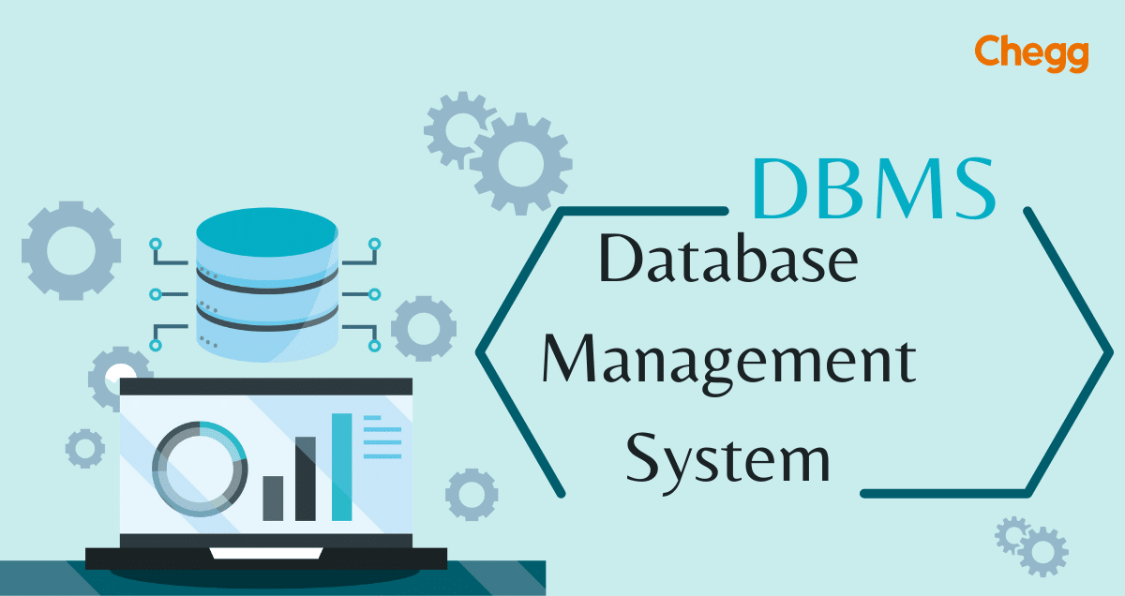
What is meant by DBMS????

Slide 8

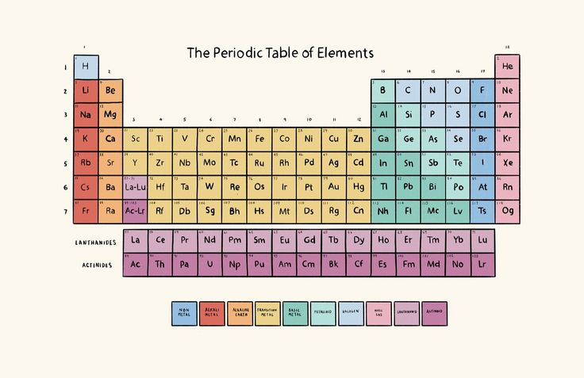
Periodic Table
Our project aims to analyze, strategize, and implement techniques to boost product sales for Warner & Spencer. We recognize the importance of a robust sales strategy and intend to explore innovative methods to enhance sales figures and market penetration.

Slide 9
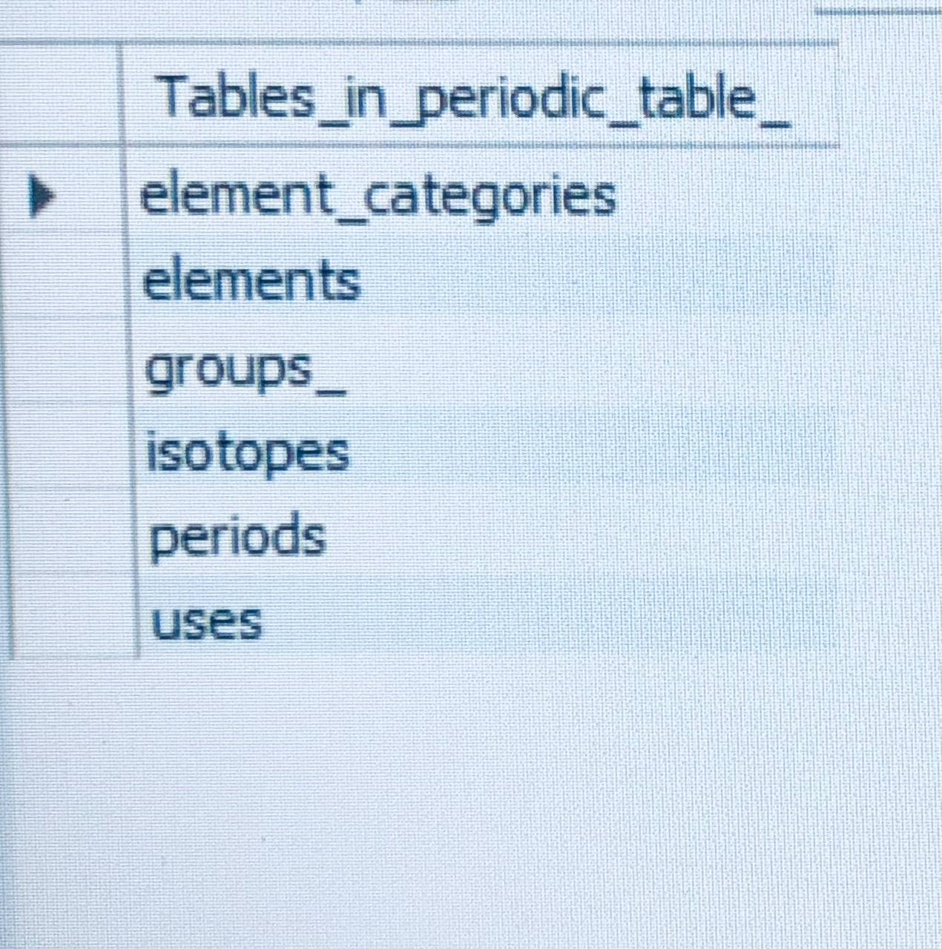
Tables
Current scenario:
Warner & Spencer has been a significant player in its industry, offering various shampoo and soap products. While they've seen success, we acknowledge the evolving market dynamics and the need to adapt our sales strategies to maintain and increase our competitive edge.

Slide 10
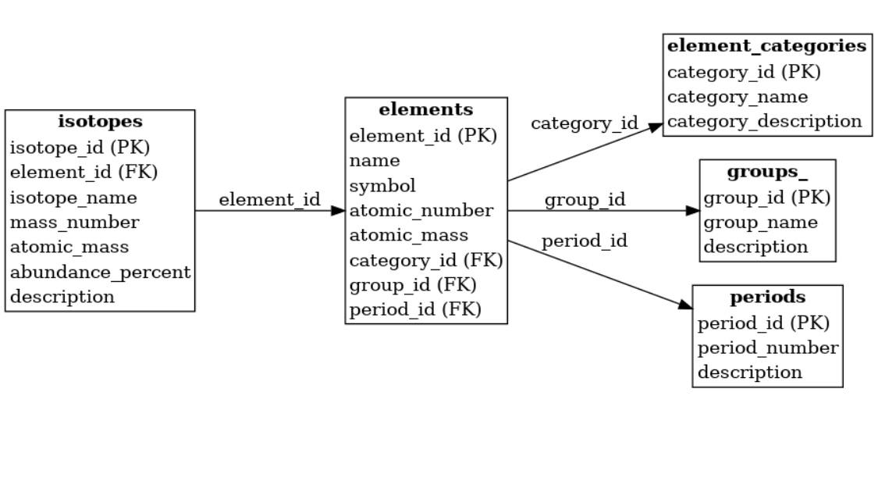
Period tables Database of ER diagram

Slide 11
Element table structure
Columns
Data Type
Constrains/Description
INT
VARCHAR(50)
VARCHAR(3)
INT
DECIMAL(10, 5)
INT
INT
VARCHAR(1)
VARCHAR(255)
VARCHAR(20)
DECIMAL(8, 2)
DECIMAL(8, 2)
DECIMAL(8, 4)
DECIMAL(4, 2)
DECIMAL(8, 2)
DECIMAL(8, 2)
TEXT
INT
AUTO_INCREMENT PRIMARY KEY
UNIQUE NOT NULL
UNIQUE NOT NULL
UNIQUE NOT NULL
NOT NULL
NOT NULL
(none)
(none)
(none)
(none)
(none)
(none)
(none)
(none)
(none)
(none)
(none)
FOREIGN KEY (category_id) REFERENCES element_categories(category_id)
element_id
-name
-symbol
-atomic_number
-atomic_mass
-period
-group_id
-block
-electron_configuration
-state_at_stp
-melting_point_k
-boiling_point_k
-density_g_cm3
-electronegativity
-ionization_energy_kj_mol
-electron_affinity_kj_mol
-description
-category_id

Slide 12
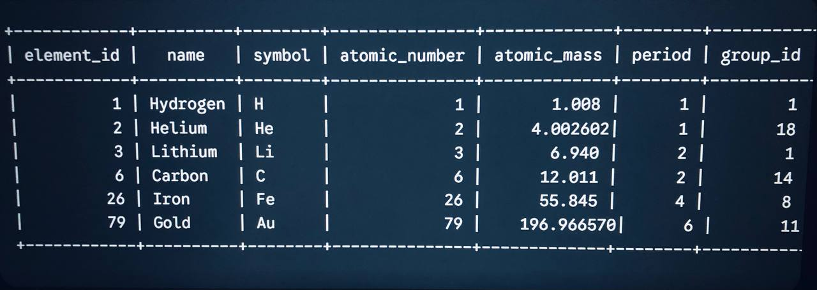
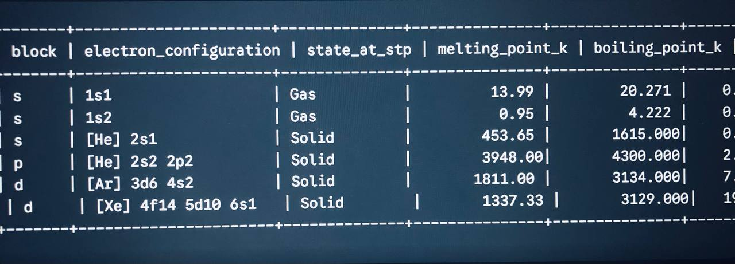
Insert data in element table
INSERT INTO elements (
name, symbol, atomic_number, atomic_mass, period, group_id, block,
electron_configuration, state_at_stp, melting_point_k, boiling_point_k,
density_g_cm3, electronegativity, ionization_energy_kj_mol,
electron_affinity_kj_mol, description, category_id
) VALUES
(
'Hydrogen', 'H', 1, 1.00784, 1, 1, 's',
'1s1', 'gas', 13.99, 20.27,
0.00008988, 2.20, 1312.00,
72.8, 'Lightest element, essential in water and organic compounds.', 1
);

Slide 13
Insert data in all tables
Isotopes table
Element caregories table
INSERT INTO element_categories (category_name, category_description) VALUES('Alkali Metal', 'Very reactive metals that readily lose their outermost electron.'),('Alkaline Earth Metal', 'Reactive metals, commonly found in the Earth''s crust.'),
INSERT INTO Isotopes (element_id, mass_number, symbol, natural_abundance, half_life_days, decay_mode, is_radioactive) VALUES
Group table
INSERT INTO Groups_ (group_id, group_name, description) VALUES(1, 'Alkali Metals', 'Highly reactive metals with one valence electron. Form +1 ions.'),
Period table
INSERT INTO Periods (period_id, period_name, description) VALUES(1, 'Period 1', 'Contains hydrogen and helium. Only 2 elements.'),(2, 'Period 2', 'Contains elements from lithium to neon. 8 elements.'),
Uses table
INSERT INTO Uses (element_id, application, details) VALUES-- Hydrogen (element_id = 1)(1, 'Fuel', 'Used as rocket fuel and in fuel cells.'),

Slide 14
Sample queries
>SELECT * FROM elements ;
>select * from element_categories;
>select * from periods;
>select * from isotopes;
>select * from uses;
-- Noble gas
SELECT e.name, e.symbol, ec.category_name
FROM elements eJOIN element_categories ec ON e.category_id = ec.category_idWHERE ec.category_name = 'Noble Gas';
---AtomicNumber
SELECT name,symbol,Atomic_number,state_at_stp
FROM elements
WHERE atomic_number<=50 AND state_at_stp=‘Solid’
ORDER BY atomic_number;

Slide 15
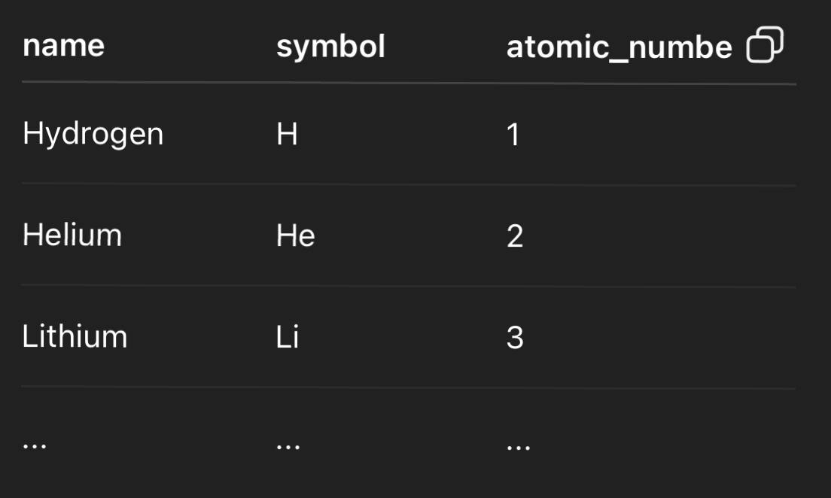
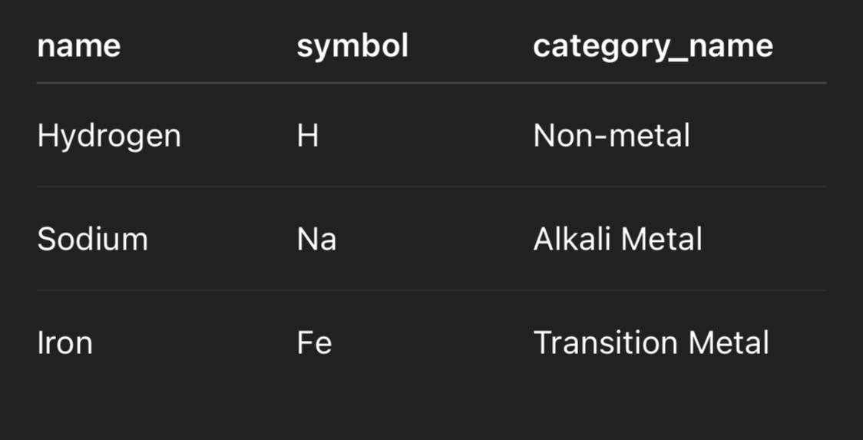
-- ordering&limiting
-- join opreation
select.name,elements.symbol,element_categories.category_name
from elements join element_categories on elements.group_id= element_categories.category_id;
select name,symbol, atomic_number from elements order by atomic_number asc;

Slide 16
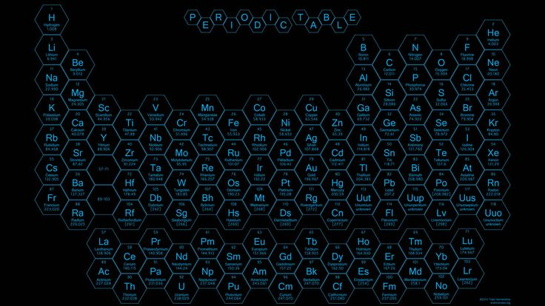
?
THANKYOU
For Your
Attention !
Got Question

